Slide 1
Talking Cybersecurity
Steve Frechette
December 6, 2017

Slide 2
What is the Internet?

Slide 3
What is the Internet?
Everyday corporate networks behind firewalls – “safe”
Everything else…Google, FB, YouTube, Reddit, etc.
What most people think

Slide 4
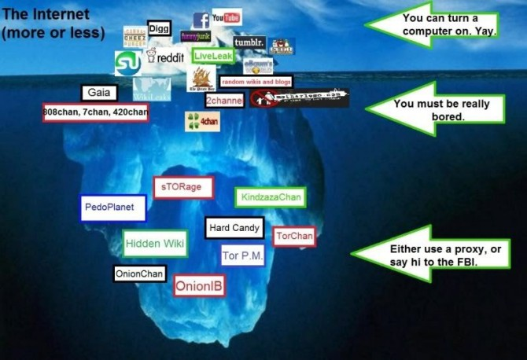

Slide 5
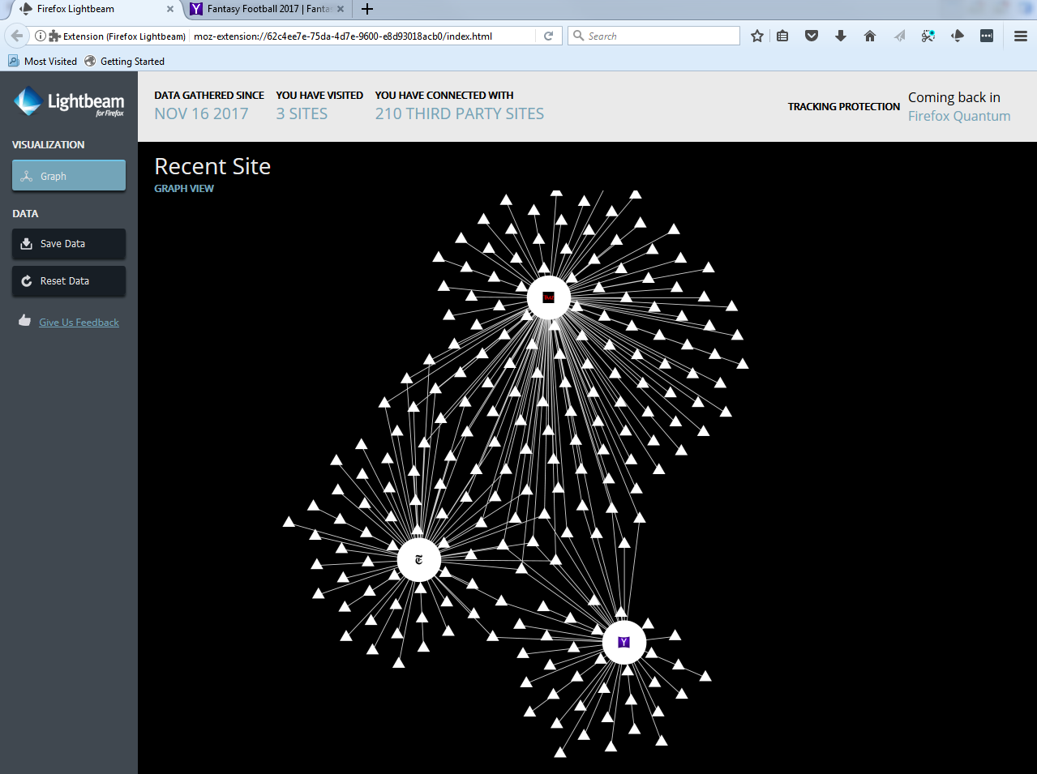
Who’s Tracking me? 5 Clicks, 10 seconds 49 sites
They are watching you…

Slide 6
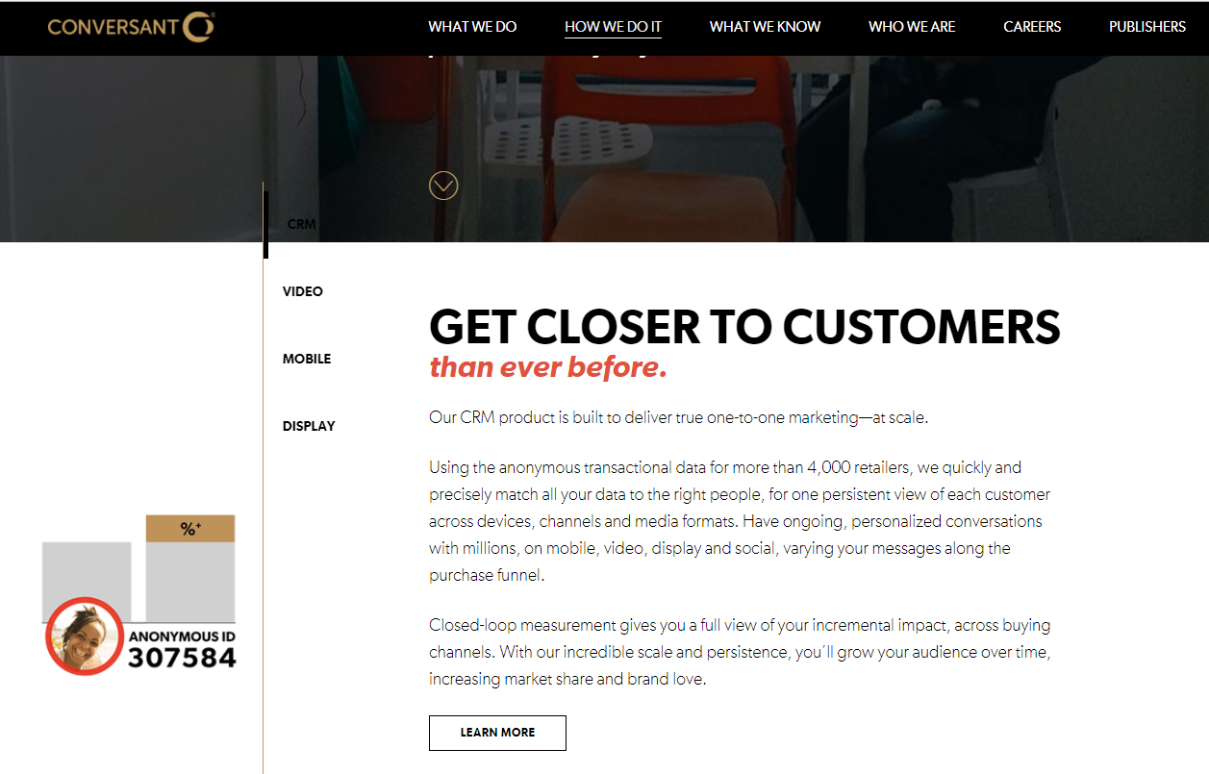
Who’s Tracking me? 5 Clicks, 10 seconds 49 sites
They are watching you…

Slide 7
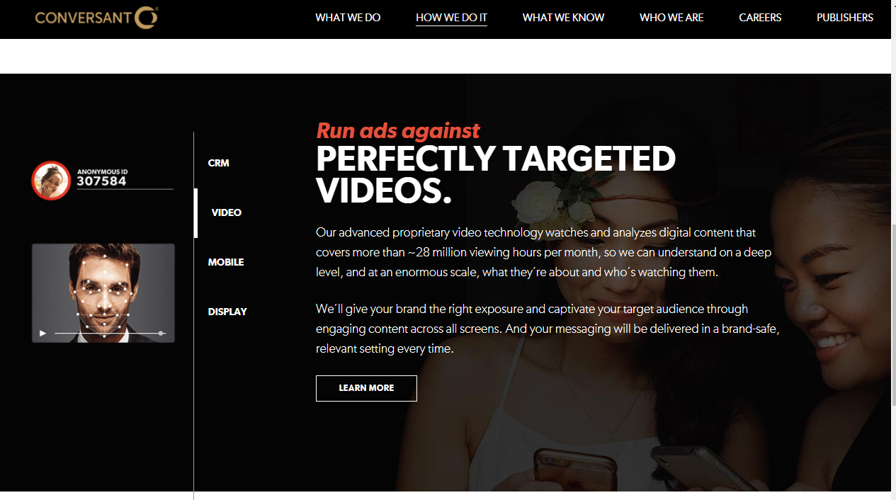
Who’s Tracking me? 5 Clicks, 10 seconds 49 sites

Slide 8
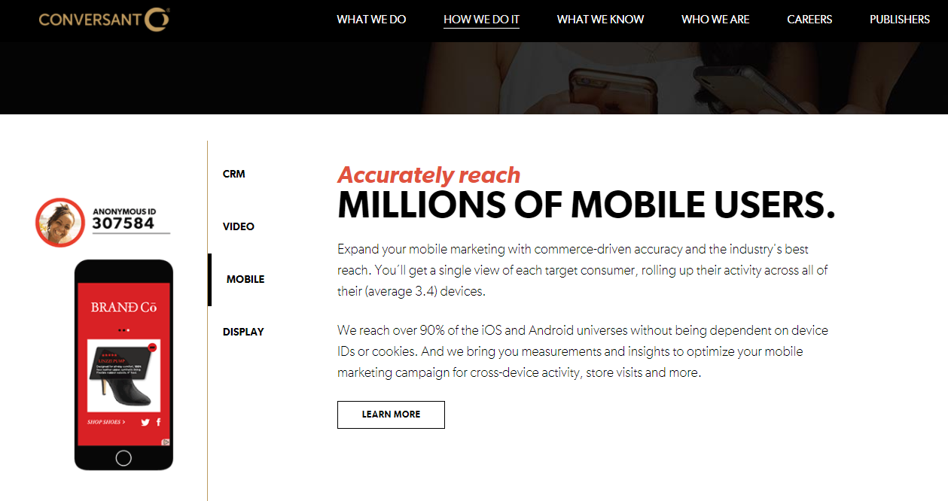

Slide 9
Takeaways
Customer or Product? Which are you?
Cows example for metadata.
Cows | Internet Users
Free Food | Free Apps
Protection | Convenience
Environment | Platforms
Output (Product or Value Produced)
Milk, Cheese, Beef, etc. | Data, personal information, preferences.

Slide 10
The Value of Data

Slide 11
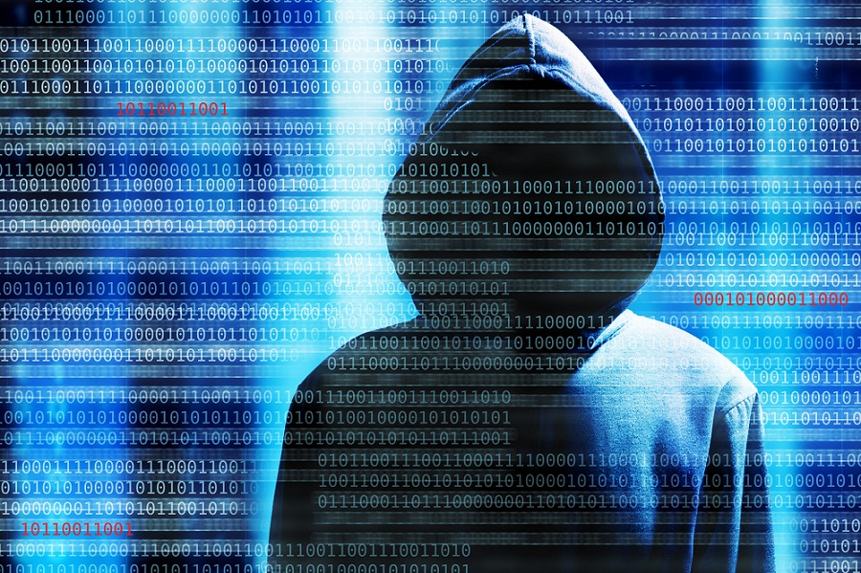
Data is Valuable – who wants it?
Good Guys :-/
Bad Guys :-(

Slide 12
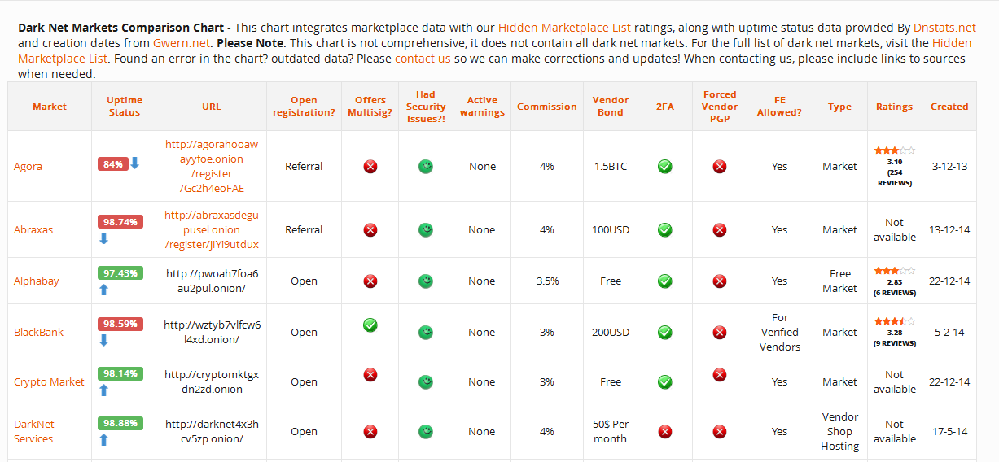
Active Black Market

Slide 13
What is Cybersecurity?
Practice by which information security analysts plan and carry out security measures to protect an organization’s computer networks and systems data from theft.
Malware
Ransomware
Cybercrime
Fastest growing crime in America: Identity Theft

Slide 14
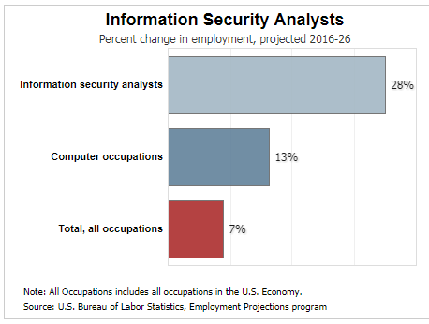
Job Outlook
Information Security Analysts
Percent Change in Employment
Demand very high
BCC Certificate Program
Bachelor’s Degree (B.S.)
Computer Science
Information Assurance
Programming
Computer Networking
Certifications
CISSP

Slide 15
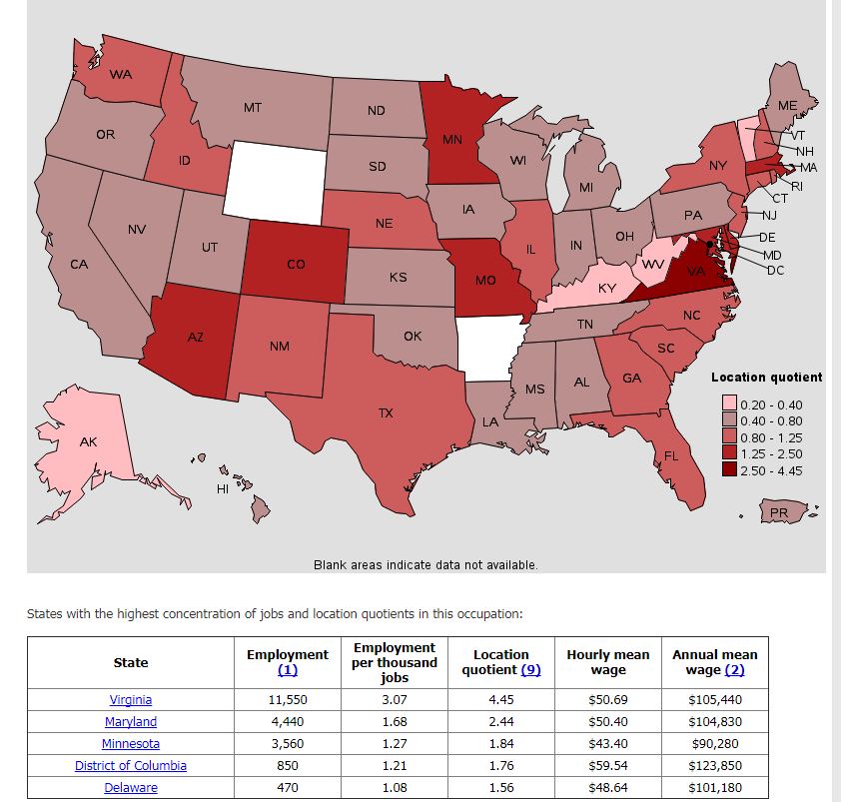
Massachusetts
Salary: $97,750

Slide 16
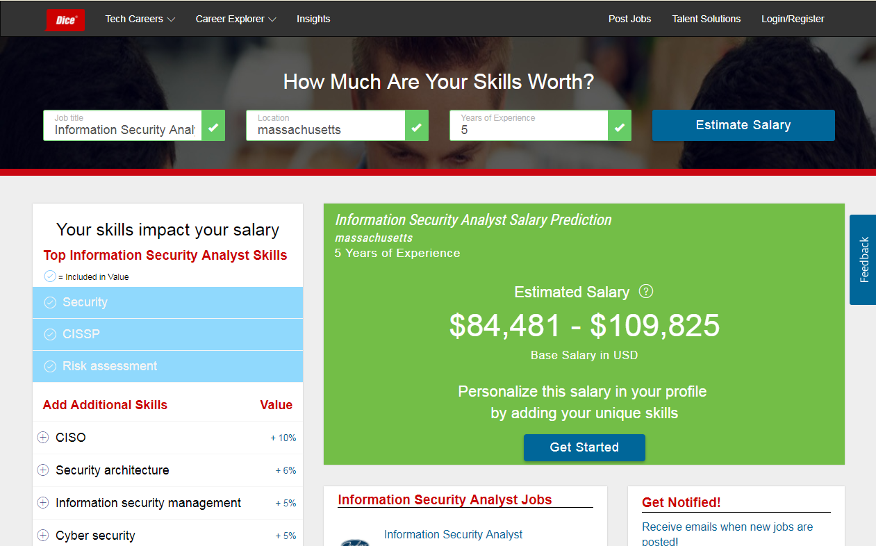
Information Security Analyst – 5 Years Experience

Slide 17
Getting Started - Paths
Certificate Program
4 Semesters
Experience, then CS degree
Computer Science Transfer
72 credits (full-time 2 years)
Transfer to UMass Dartmouth
2 Years at UMD
B.S. Computer Science
*see transfer agreement*
Average starting salary:
$71,500 per year + benefits

Slide 18
Thank you.
Questions?

